Slide 1



Sustainable AI
Group Members
Jose George
Abdullahi
Albright
Lesley

Slide 2
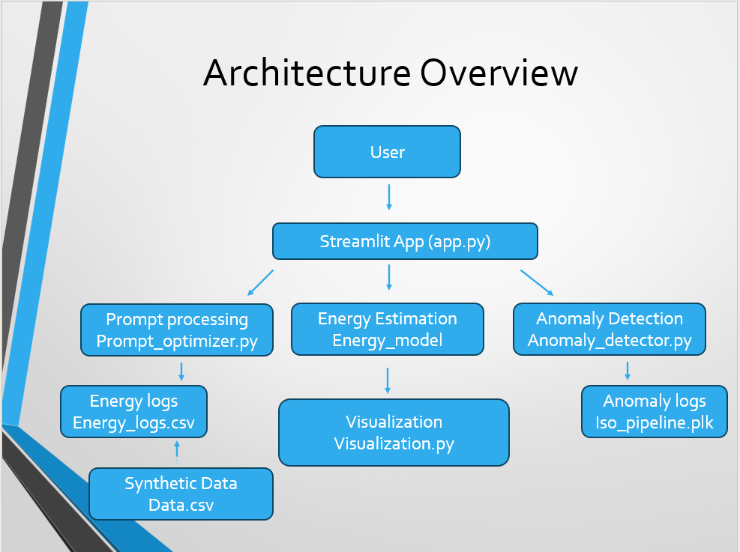
Document architecture

Slide 3

Introduction
AI models are becoming larger, costlier, and more carbon-intensive.
By 2026, the EU AI Act requires model energy transparency.
1,240+ AI data centers globally increase electricity, water use & emissions.
Goal: build a pipeline for energy prediction, prompt optimization, and anomaly detection.

Slide 4
Problem Being Addressed
Lack of transparency in AI compute + energy usage.
Inefficient prompts waste tokens and energy.
Environmental strain from data centers.
Need: automation for energy‑efficient AI workloads.

Slide 5
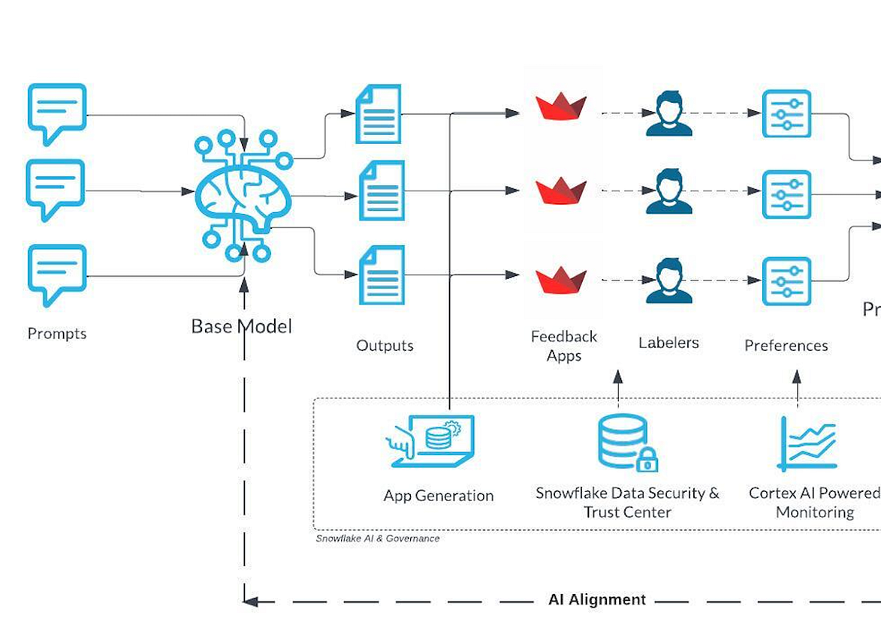
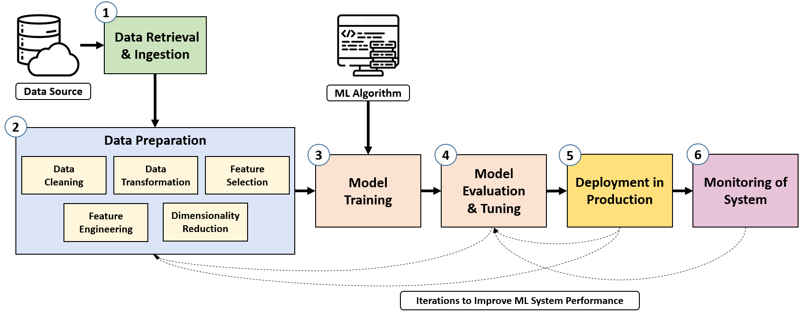
Pipeline Overview
Stages:
1. Synthetic Dataset
2. Energy Predictor Model
3. Prediction Engine
4. Prompt Analyzer + Optimizer
5. Anomaly Detection
6. Streamlit UI

Slide 6
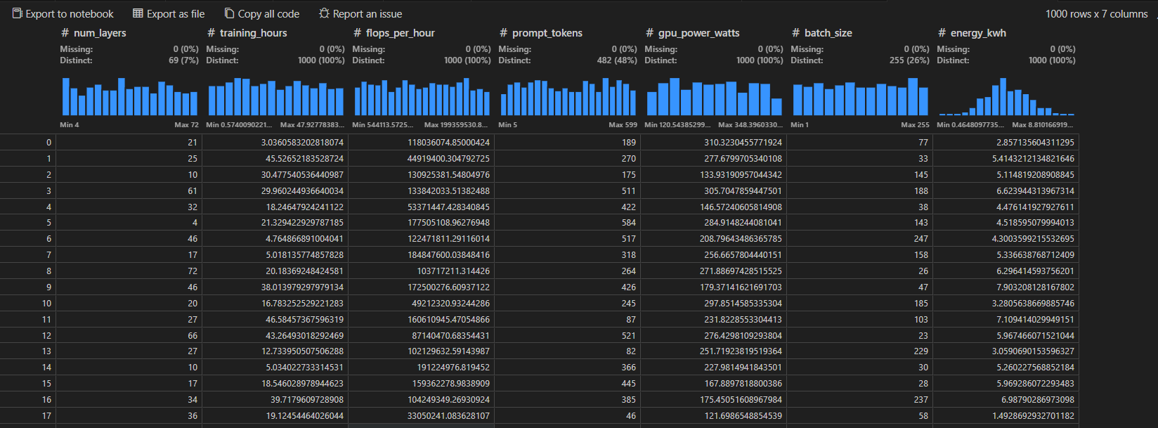
Synthetic Dataset
Generated 500+ synthetic samples.(1000 * 7)
Features: layers, FLOPs, tokens, GPU watts, batch size.
Features represent real compute factors
Enables model to learn realistic energy patterns.

Slide 7
Energy Predictor Model
Regression model predicts energy_kWh.
Identifies high‑impact parameters.
Core to sustainability + EU compliance.
 | Linear Regression | Random Forest Regressor
MAE | 0.5606 | 0.6373
RMSE | 0.7054 | 0.8102
R-squared | 0.7721 | 0.6994
The Selected best model: Linear Regression
The model identifies cost drivers using feature importance, coefficient analysis, and SHAP values, revealing that FLOPs, GPU power, and training hours contribute most to energy consumption.

Slide 8
Prediction Engine
• Wraps trained model into reusable function.
• Input: configuration → Output: predicted kWh.
• Used by analyzer, optimizer & UI.

Slide 9
Prompt Analyzer
Token counter + redundancy checker.
Computes compute cost and projected energy.
Detects inefficient user prompts.

Slide 10

How the Prompt Analyzer Works
Breaks down the prompt into measurable components Length, token distribution, sentence complexity, and redundancy patterns.
Estimates downstream computational cost Uses the Prediction Engine to forecast FLOPs, GPU power, and expected energy (kWh) for the prompt.
Highlights sources of inefficiency Identifies filler phrases, repeated instructions, and unnecessary verbosity that increase token count and energy usage.
Provides structured insights for optimization Outputs a “diagnostic report” that guides the Prompt Optimizer in rewriting the prompt to be shorter, clearer, and more energy-efficient.

Slide 11
Prompt Optimizer
• Shortens prompt while preserving meaning.
• Uses rule‑based + ML rewriting.
• Reduces token count → reduces energy.

Slide 12
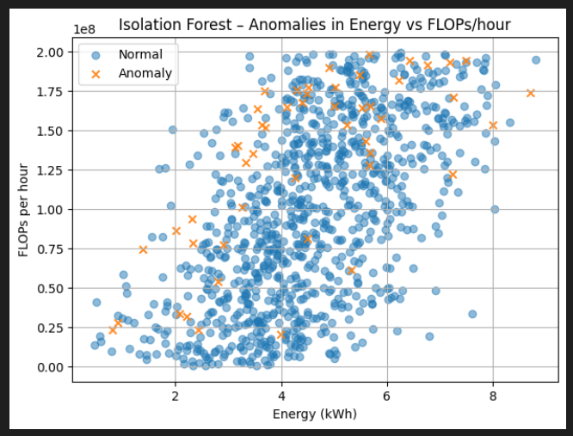
Anomaly Detection
• Flags abnormal resource usage.
• Detects token spikes, model drift, injection‑like prompts.
• Enhances safety and reliability.
Uses Isolation Forest Model to predict spikes

Slide 13
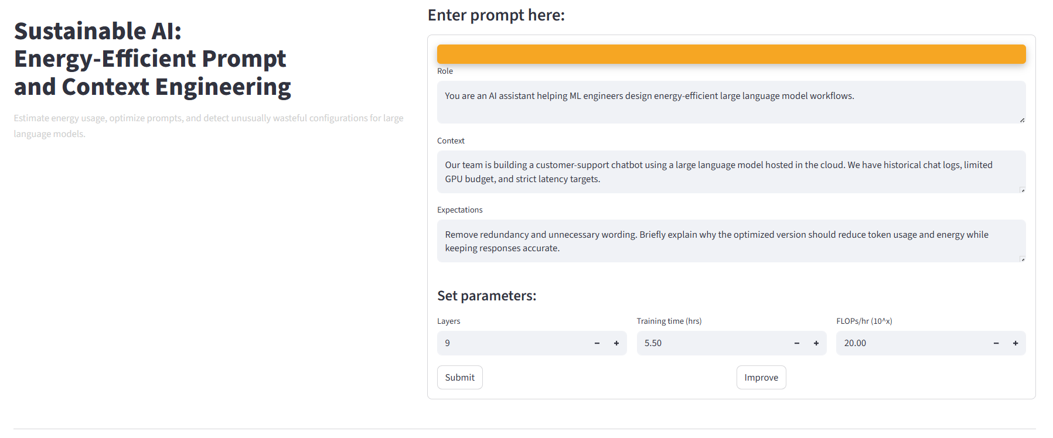
Streamlit UI
User enters prompt → system analyzes.
Displays optimized prompt, kWh, token savings.
Real‑time anomaly reporting.

Slide 14
Demo Workflow
1. Enter prompt
2. Analyzer evaluates
3. Prediction engine estimates energy
4. Optimizer rewrites
5. UI displays improvements

Slide 15
Results
• Token reductions → lower energy.
• Clear transparency dashboards.
• Detects anomalies early.
• Deployable in real‑world AI ops.

Slide 16

Conclusions
Our project demonstrates a complete pipeline for transparent, energy-aware AI systems, aligning with upcoming EU sustainability requirements.
The energy prediction model, prompt analyzer, optimizer, and anomaly detector work together to reduce token usage, lower energy consumption, and improve efficiency.
By integrating these components into an interactive Streamlit interface, we show how organizations can monitor, predict, and optimize AI workloads in real time.
Overall, the solution highlights the importance of responsible AI, enabling both sustainability and operational cost savings.

Slide 17

Recommendations
• Integrate energy dashboards into AI tools.
• Train on real operational metrics.
• Expand anomaly detection capabilities.

Slide 18
Questions
Thank you.
We welcome your questions.

